Slide 1


Binary logic and arithmetic

Slide 2
What is Binary and Binary Arithmetic?
Binary is a base-2 number system that uses two states 0 and 1 to represent a number. We can also call it to be a true state and a false state. A binary number is built the same way as we build the normal decimal number.
Binary arithmetic is an essential part of various digital systems. You can add, subtract, multiply, and divide binary numbers using various methods. These operations are much easier than decimal number arithmetic operations because the binary system has only two digits: 0 and 1.

Slide 3
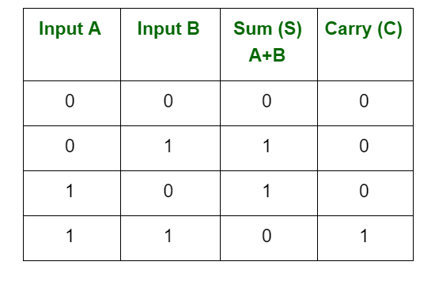
Binary Addition
In fourth case, a binary addition is creating a sum of (1 + 1 = 10) i.e. 0 is written in the given column and a carry of 1 over to the next column.

Slide 4
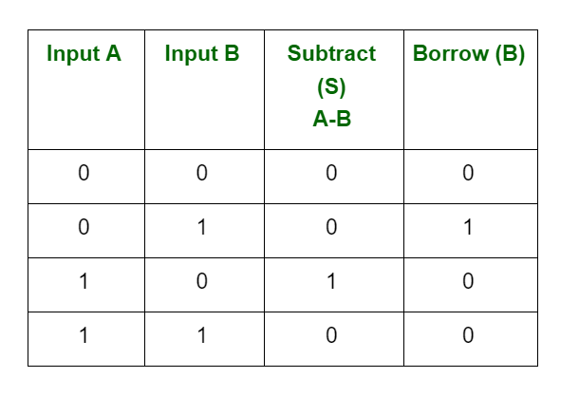
Binary Subtraction
Subtraction and Borrow, these two words will be used very frequently for the binary subtraction. There are four rules of binary subtraction.

Slide 5
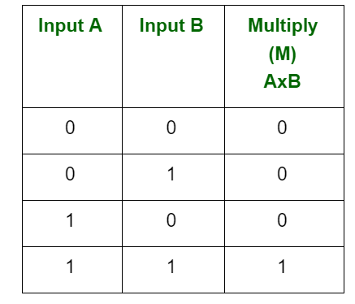
Binary Multiplication
Binary multiplication is similar to decimal multiplication. It is simpler than decimal multiplication because only 0s and 1s are involved. There are four rules of binary multiplication.

Slide 6
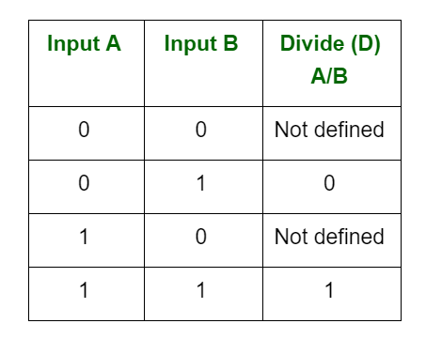
Binary Division
Binary division is similar to decimal division. It is called as the long division procedure.

Slide 7
Binary Logic
Binary logic begins with statements containing variables such as X or Y.
These three operations provide a remarkably compact and powerful tool kit for expressing any logical conditions imaginable. A particularly important type of such a logical condition is an “if–then” relationship, which tells us that if a certain set of statements has some particular set of values, then another related statement, often called the target statement, has some particular value.

Slide 8
AND (sometimes called “intersection” and indicated by the symbol • or ∗) means that, given two statements X and Y, if both are true, then X • Y = 1. If either one is false, then X • Y = 0. For example, the statement “It is raining (X) and the sun is out (Y)” is true only if both it is raining and the sun is out.

Slide 9
OR (sometimes called “union” and indicated by the symbol + ) the inclusive “or” means that, given two statements X and Y, if either one or both are true, then X + Y = 1, while only if both are false is X + Y = 0. For example, the statement “It is raining (X) or the sun is out (Y)” is true in all cases except when both are not true.

Slide 10
NOT (sometimes called “negation” and indicated here by the post symbol ′ as in X′, but sometimes indicated in other texts with an overbar as in X¯) is an operation performed on a single statement. If X is the variable representing that single statement, then X′ = 0 if X = 1, and X′ = 1 if X = 0. Therefore, if X is the variable representing the statement “It is raining,” then X ′ is the variable representing the statement “It is not raining.”

